Slide 1
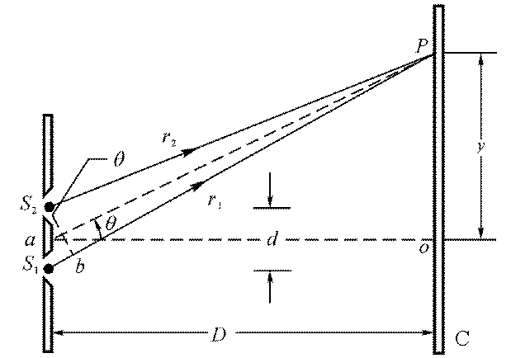
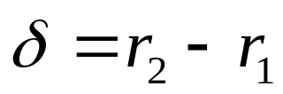

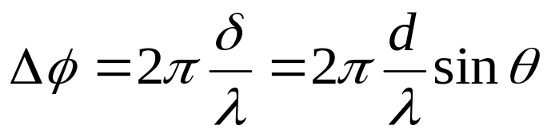
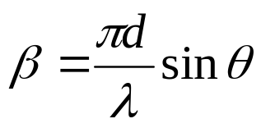
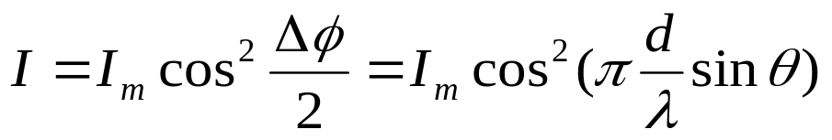

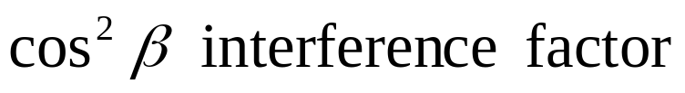
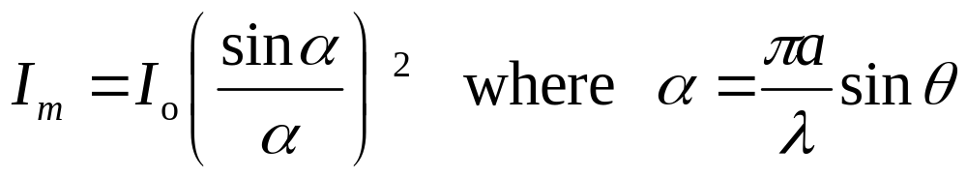
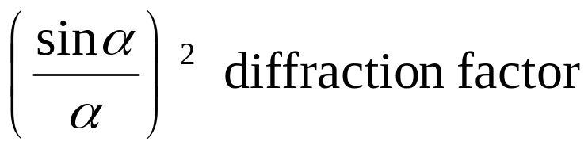
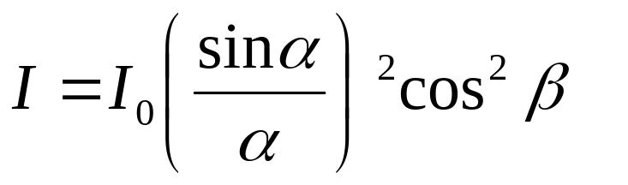
Double-slit Interference and Diffraction Combined
Each slit
Combined

Slide 2
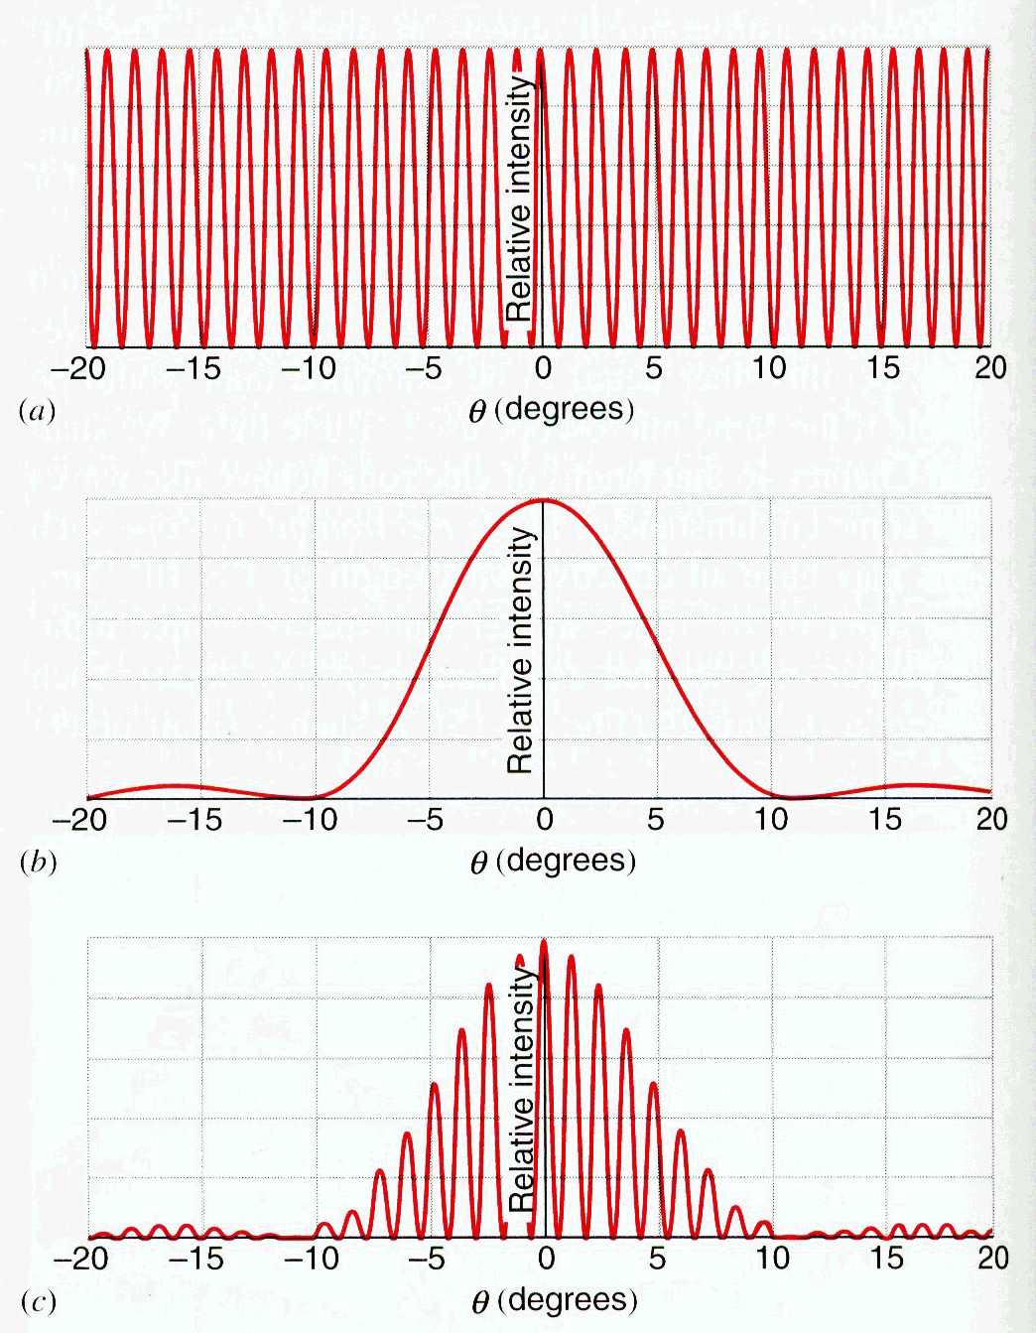
Diffraction
1-slit
2-slit

Slide 3
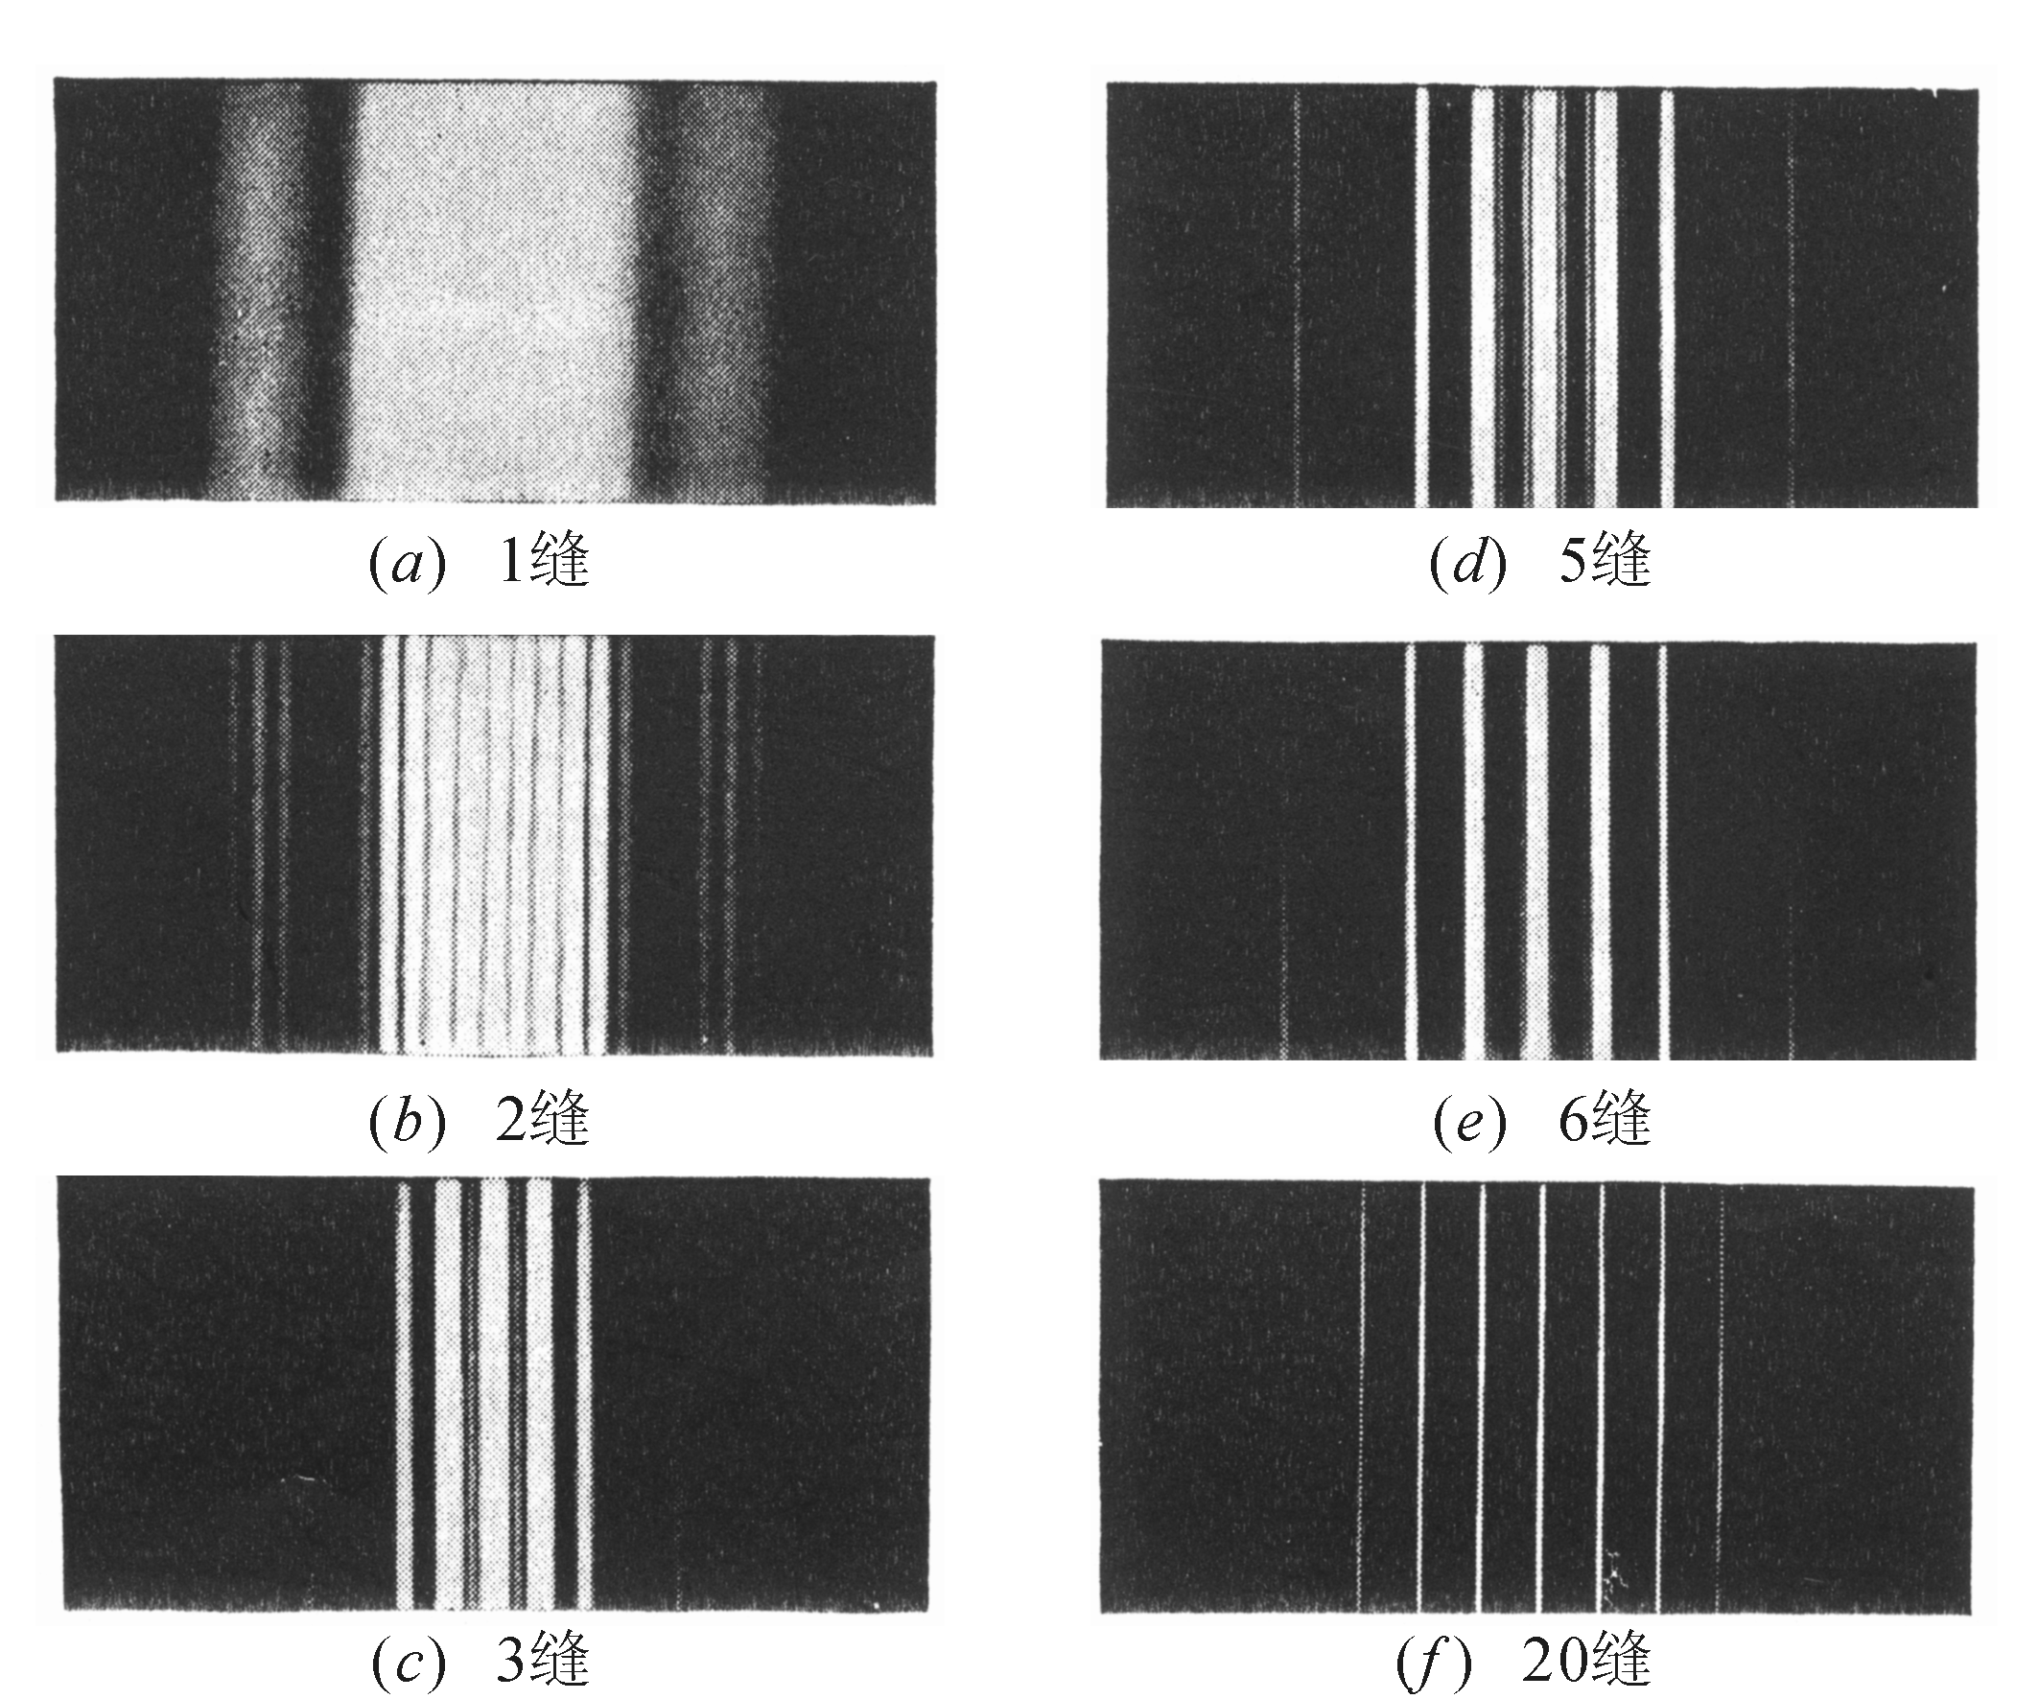
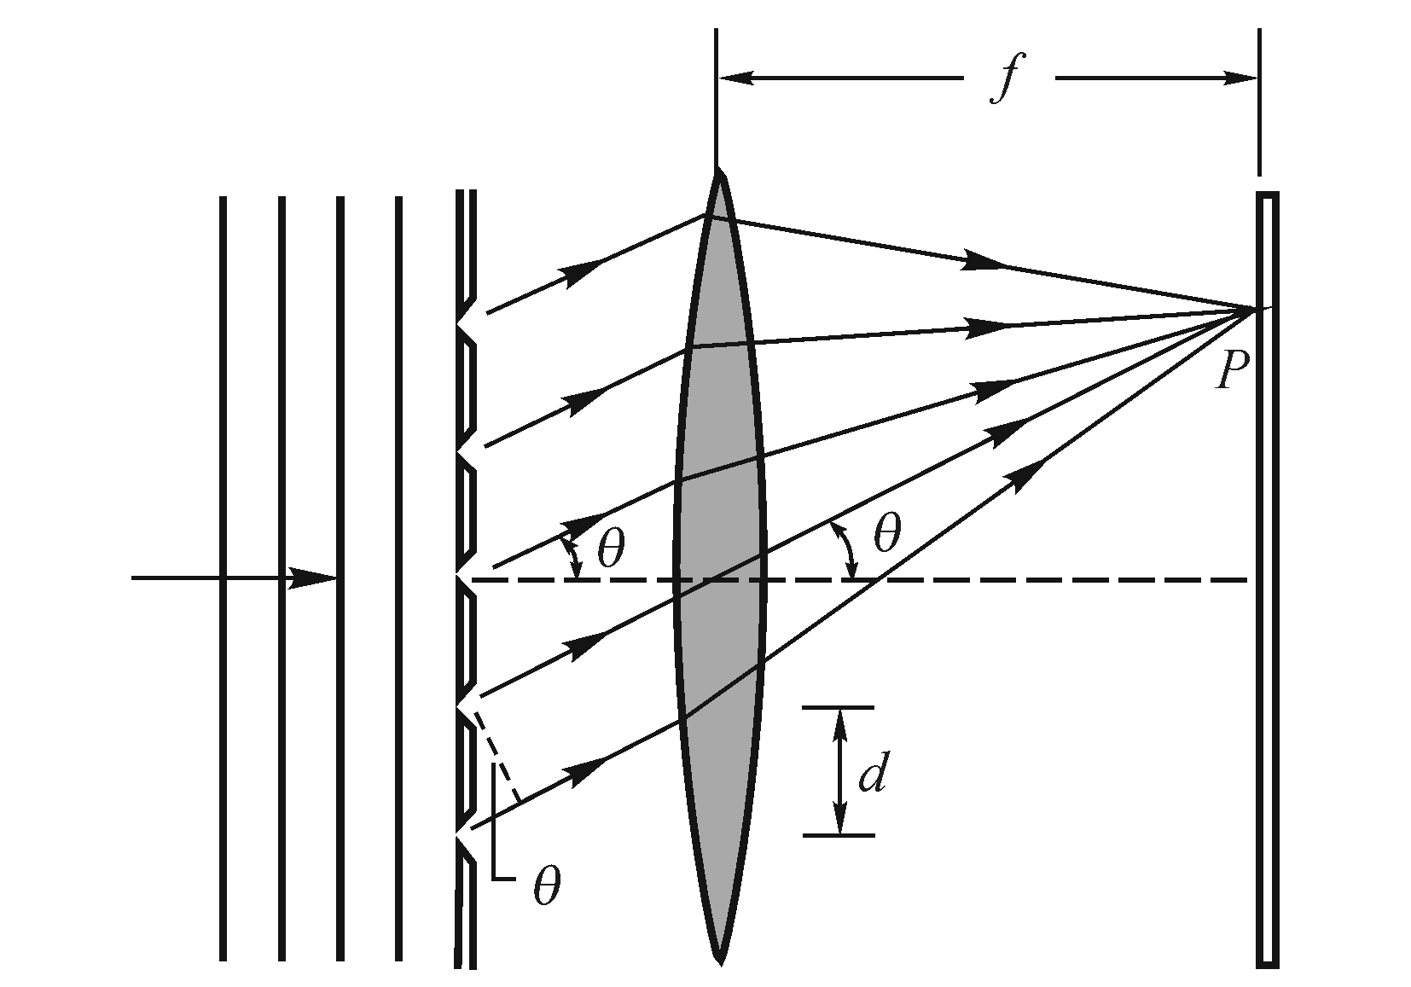






Gratings
Diffraction
1-slit
Diffraction Interference
2-slit
Multiple slits?
N is increasing, the maximum become sharper

Slide 4
Chapter 43 Gratings and Spectra

Slide 5
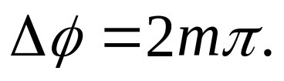


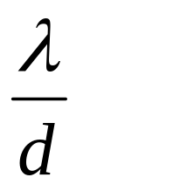

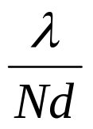
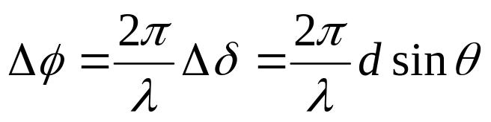
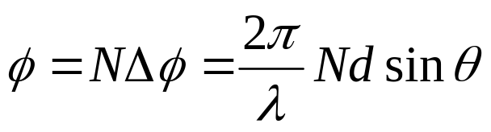


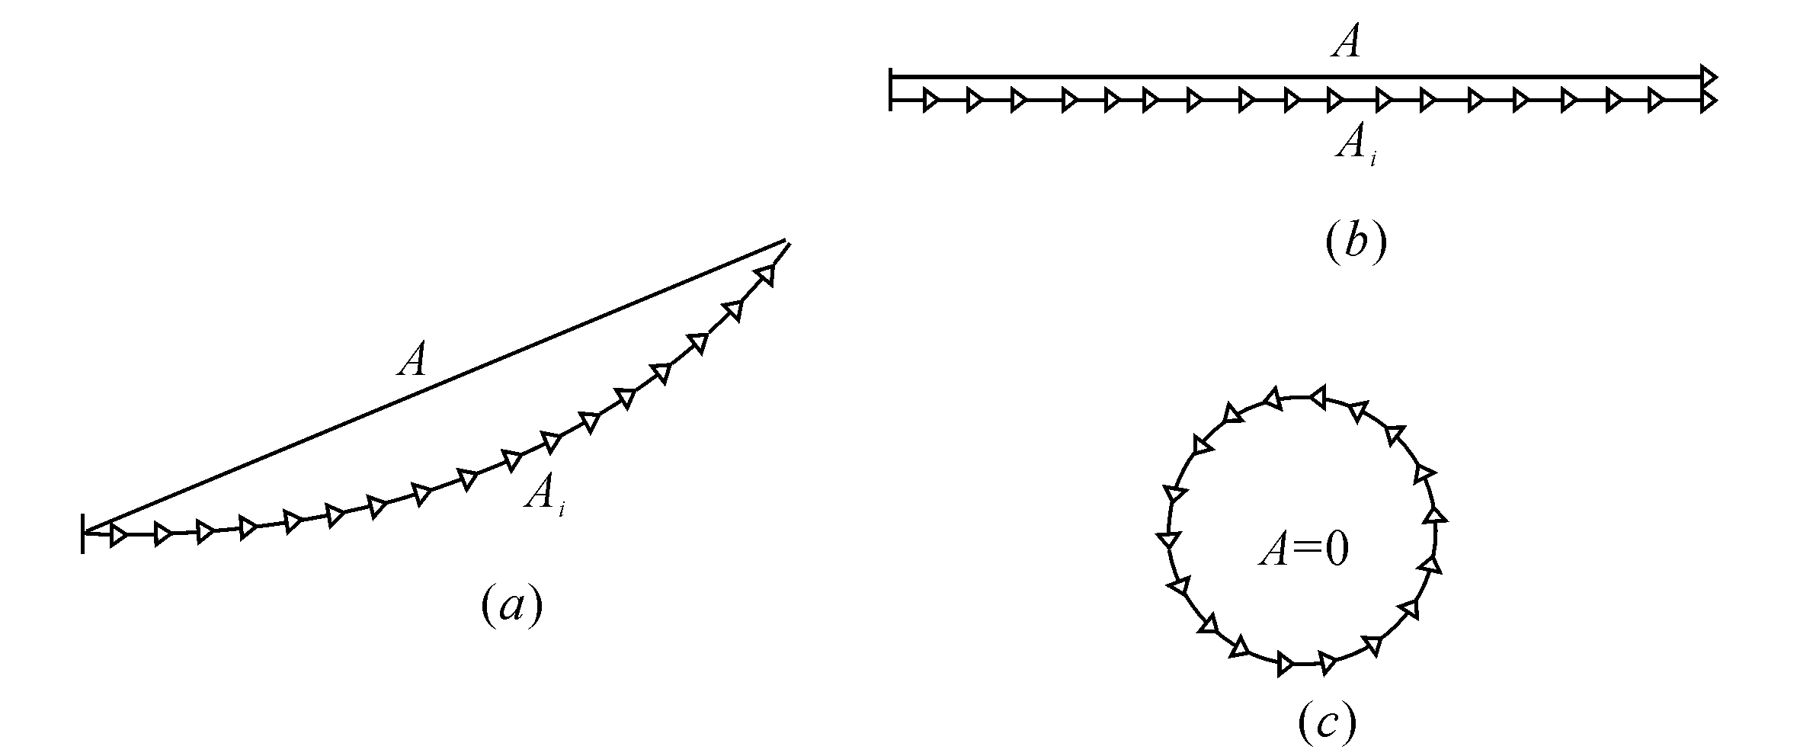
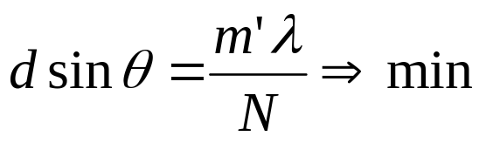



The location of principal maxima is determined by:
Principal maxima
d is slip separation, also is called grating constant (grating spacing).

Slide 6



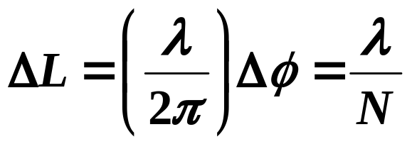

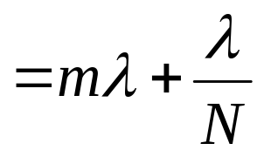

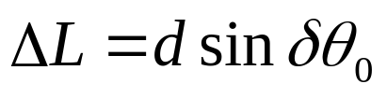
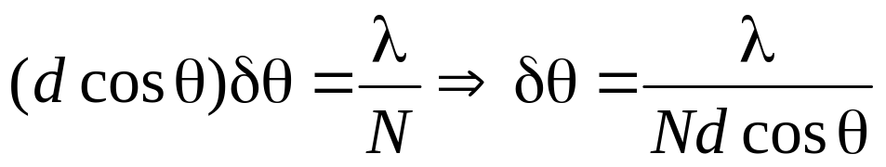
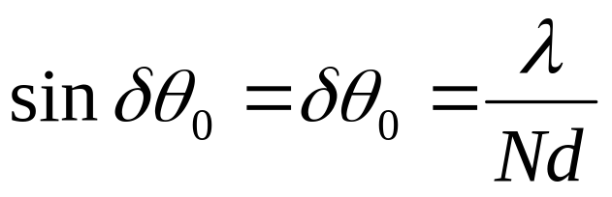
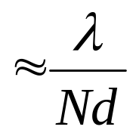
 Width of the maxima
N is increasing, the δθ is decreasing, the maxima become sharper

Slide 7
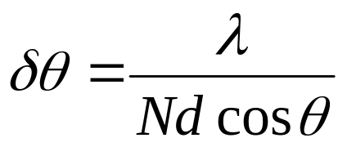

 Secondary maxima
There are some minima between two principal maxima.
Secondary maxima
Superposition of some phasors

Slide 8
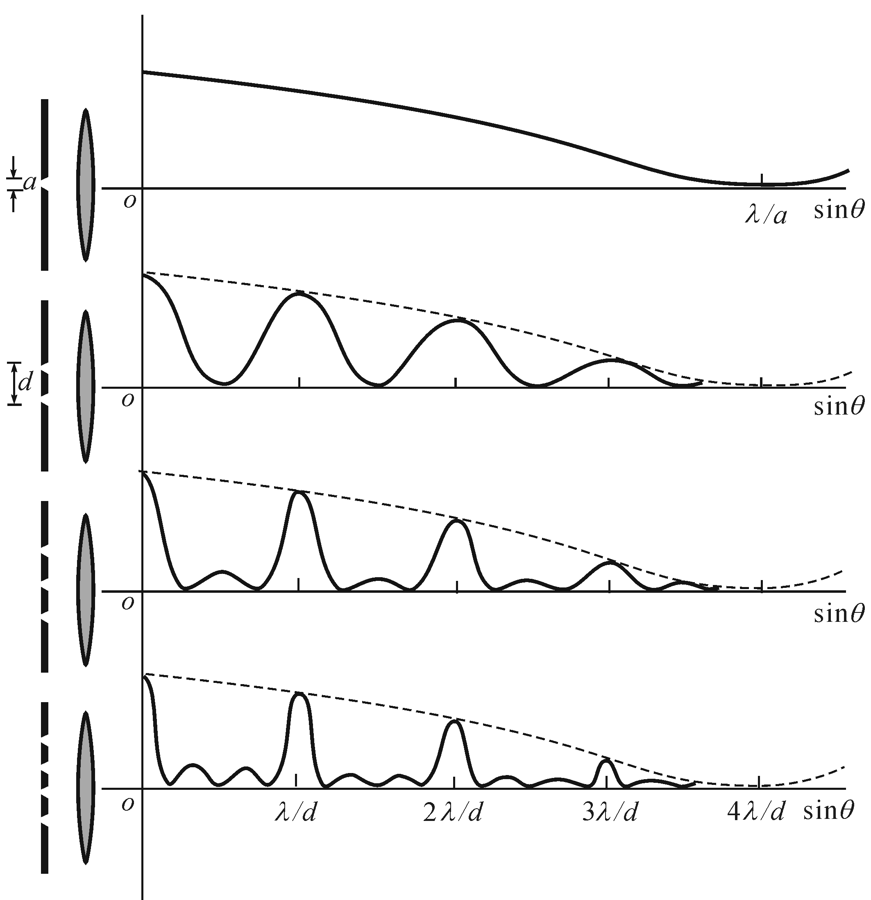
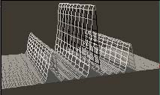
If the grating has N slips, there are N-1 minima between two principle maxima.
Δφ=0, 2π
1
N=5
3
2
1
3
2
3 slips
If the grating has N slips, there are N-2 secondary maxima between two principle maxima.
There are 2 minima between two principal maxima.
Δφ=2π/3
Δφ=4π/3
Δφ=0, 2π, ….
N is increasing, the δθ is decreasing, the maxima become sharper
4 slips
Δφ=π/2
Δφ=π
Δφ=3π/2
There are 3 minima between two principal maxima.

Slide 9
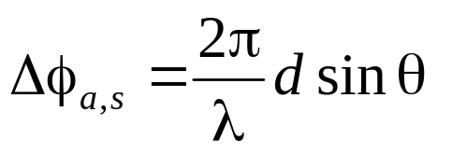
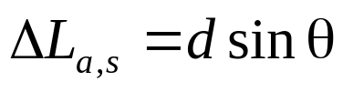
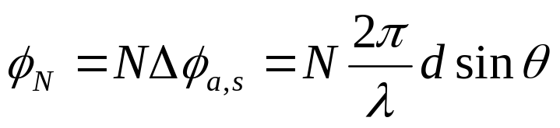
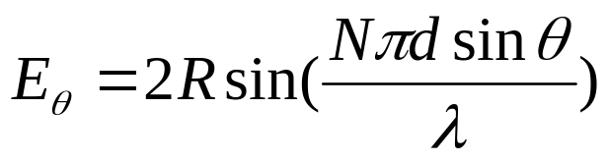
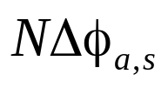

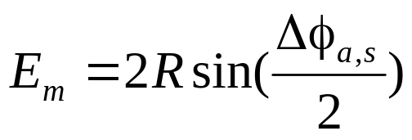
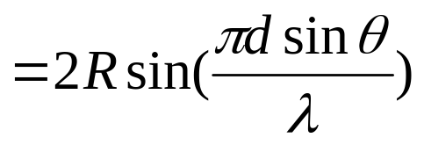

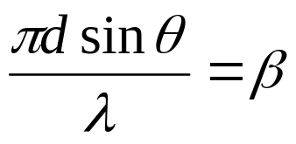
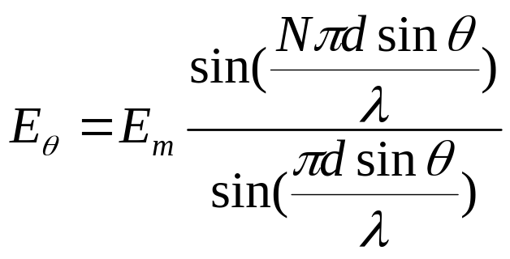

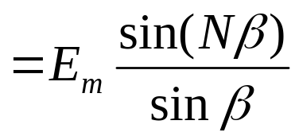

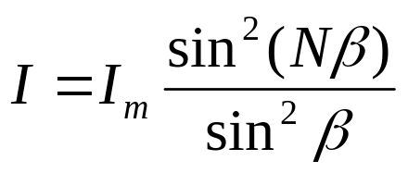
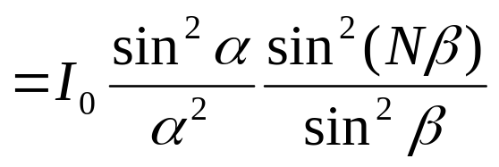

 Intensity distribution
ΔL

Slide 10



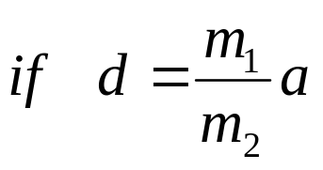


 Missing order
m^{th} fringe is missing
single-slit diffraction
m₁th fringe is missing
double-slit interference
grating

Slide 11
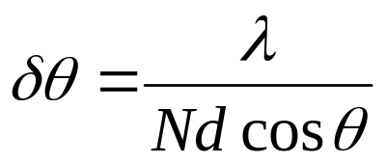
summary
ΔL
Width of the maximum
If the grating has N slips, there are N-1 minima between two principle maximum, and there are N-2 secondary maximum
N is increasing, the δθ is decreasing the maximum become sharper

Slide 12
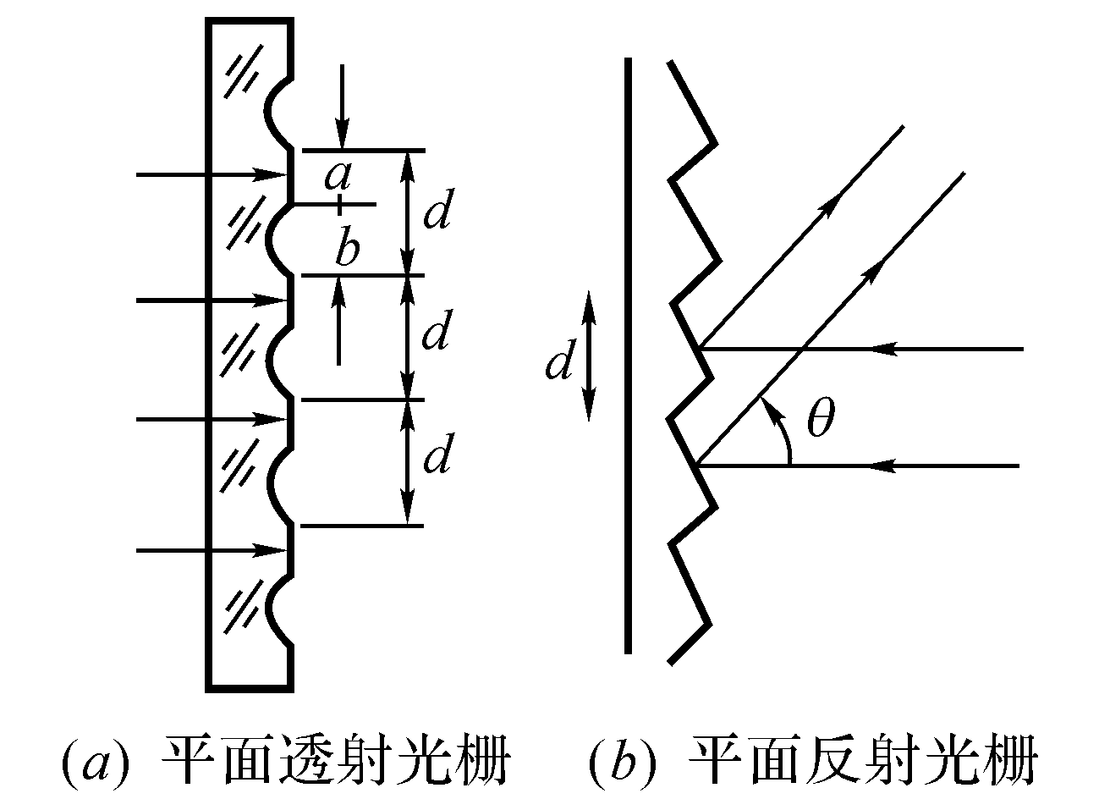
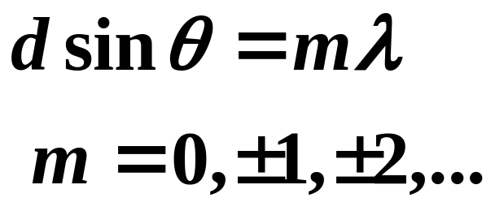
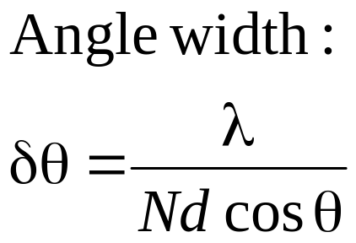
Kinds of gratings
Diffraction gratings
Transmission grating
Reflection grating

Slide 13
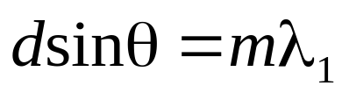
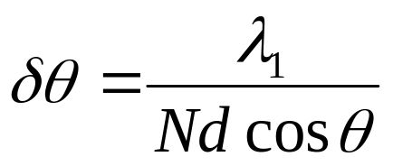
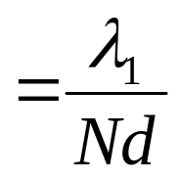

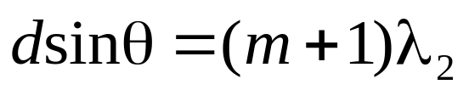
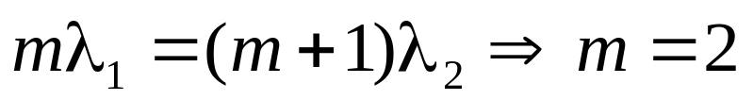





Example: A grating (N=5000) is illuminated by two monochromic lights with wave lengths of 600 and 400 nm respectively. The mth principal maximum of the former light is meet the (m+1)th principal maximum of the later at 3 cm from the central fringe on the screen. The focus length of the lens is 50 cm. Find the grating constant d, and the typical width of the principle fringes.

Slide 14
Homework:
P977-978 18, 24, 29
P996 6, 9

Slide 15









Grating
sinθ
If the grating has N slips, there are N-1 minima and N-2 secondary maxima between two principle maxima.

Slide 16
Grating
If the grating has N slips, there are N-1 minima and N-2 secondary maxima between two principle maxima.
Transmission grating
Reflection grating

Slide 17

Diffraction Grating
θ

Slide 18

Diffraction Grating
Spectra of light
θ
3rd (m=3)
1st (m=1)
2nd (m=2)
central

Slide 19













Dispersion and resolving power
To display the light with different wavelength
Dispersion
Resolving power
The ability of a grating is determined by two intrinsic properties of the grating:
(1)Δθ/Δλ
(2)the width of the line

Slide 20








Dispersion and resolving power
To display the light with different wavelength
Dispersion
resolved
just resolved
not resolved
Resolving power

Slide 21







Dispersion and resolving power
Example
Dispersion

Slide 22











Example
A grating N=9600, with width W=3.00cm,
line spectrum of mercury vapor (λ=546 nm).
What is dispersion D in 3nd order (m=3)
What is resolving power R in 5th order (m=5)

Slide 23







Example
A grating with width W=4.15 cm. To resolve λ₁=415.496 nm and λ₂=415.487 nm in the second order, what is N? At what angle is 2nd maximum? Whis the width of 2nd maximum?

Slide 24




Example
Wave length λ
φ
θ
d
When θ = 30⁰ wave is m^{th} max
What is θ, for (m+1)^{th} max

Slide 25

Gratings
Spectrum
Structure of crystal

Slide 26




X-ray Diffraction
crystal
As a gratings
d
Crystal solid
Constructive interference:
in NaCl
1st maximum will be at 9°
λ=0.17nm
2nd maximum will be at 20°
3rd maximum will be at 31°

Slide 27







 Wavelength:
 Bragg’s law
Laue experiment
Determination of crystalline structures
Laue spots

Slide 28





Example
A X-ray with λ=0.10 nm to 0.14nm, A crystal with a₀=0.263nm,
If a diffraction beam is to exist, when θ =45⁰
θ
What is m, λ?
a₀

Slide 29





Example
A X-ray with λ=0.110 nm, A crystal with a₀=0.563nm,
If a diffraction beam is to exist, θ =?
d
a₀
θ

Slide 30









Example
A X-ray with λ=0.110 nm, the incidence angle is 60⁰, assuming the scattering is from the dashed planes, find the unit cell size a₀
d
60⁰
α
a₀

Slide 31
Exercises
P996-997 7, 11, 17, 19, 27, 33

